Slide 1
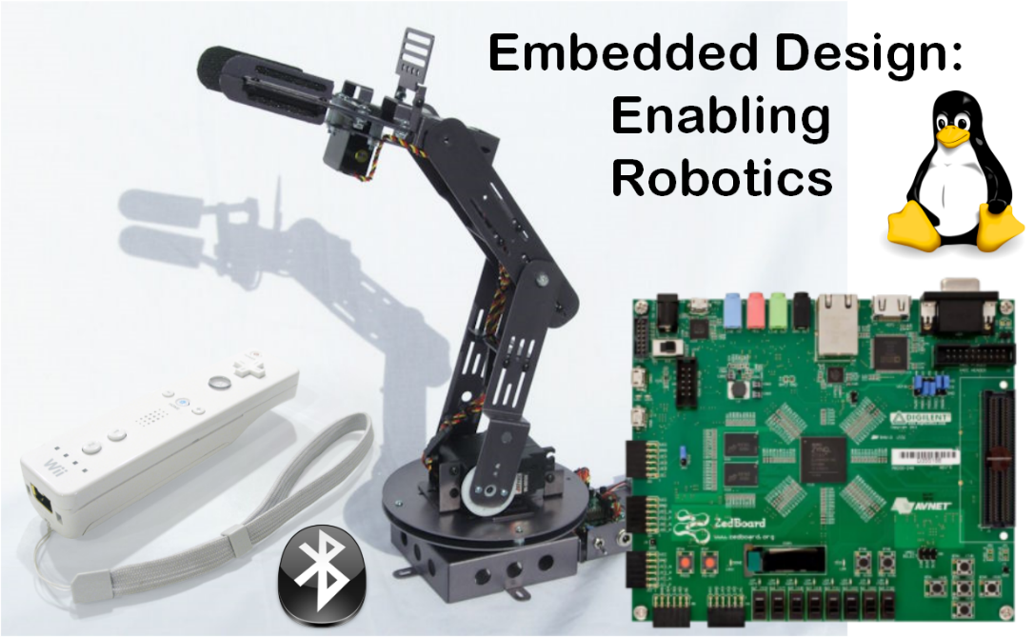
EECE 2160

Slide 2
EECE 2160: Embedded Design: Enabling Robotics
Prof. John Kimani
Office Hours 10:00am - 12:00pm on Wed & Thu (Dana 410)
2:45pm - 4:15pm on Mon (in Hayden 009)
(617)-373-6398
j.kimani@neu.edu

Slide 3
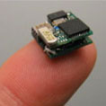
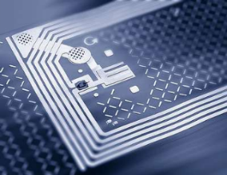
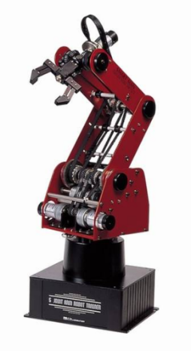
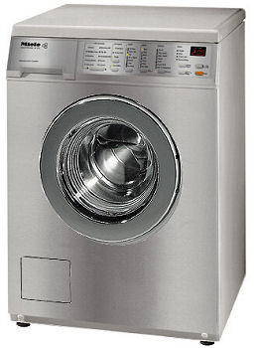
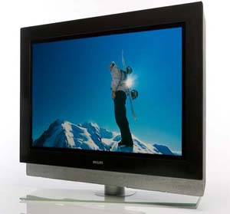
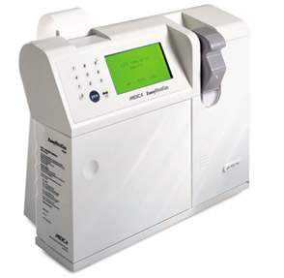
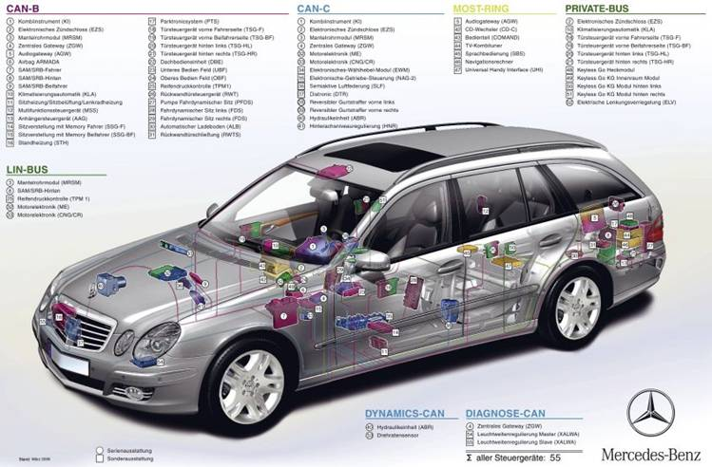
Embedded Systems
A computer system embedded into another system
Constraints from external input / output
Application specific
Diverse set of application areas
Omnipresent, ubiquitous
Huge market
‘05: only 2% processors in workstations
Remaining 8.8 billion in embedded systems
$46 billion in ‘04, >$90 billion by 2010
Source: P. Chou, UCI
Source: Edumicator
Source: Miele
Source: Philips
Source: www.trouper.com
Source: www.medicacorp.com/

Slide 4

Key ideas in this course
Abstraction
Productivity enhancer – don’t need to worry about details…
We can drive a car without knowing how the internal combustion engine works
…until something goes wrong!
Where’s the dipstick? What’s a spark plug? Am I out of gas?
Important to understand the components and how they work together
Hardware vs. Software
It’s not either/or – both are components of a computer system
Even if you specialize in one, you should understand capabilities and limitations of both

Slide 5
Turing Machine - Abstraction
Mathematical model of a device that can perform any computation – Alan Turing (1937)
ability to read/write symbols on an infinite “tape”
state transitions, based on current state and symbol
Every computation can be performed by some Turing machine (Turing’s thesis)
T_{add}
T_{mul}
a, b
a + b
a, b
a * b
Turing machine that adds
Turing machine that multiplies
For more info about Turing machines, see
http://www.wikipedia.org/wiki/Turing_machine/
For more about Alan Turing, see
http://www.turing.org.uk/turing/

Slide 6
Universal Turing Machine
A machine that can implement all Turing machines -- this is also a Turing machine!
inputs: data, plus a description of computation (other TMs)
T_{add}, T_{mul}
U
a, b, c
c(a+b)
Universal Turing Machine
U is programmable – so is a computer!
instructions are part of the input data
a computer can emulate a Universal Turing Machine
A computer is a universal computing device!

Slide 7
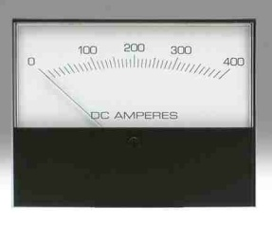
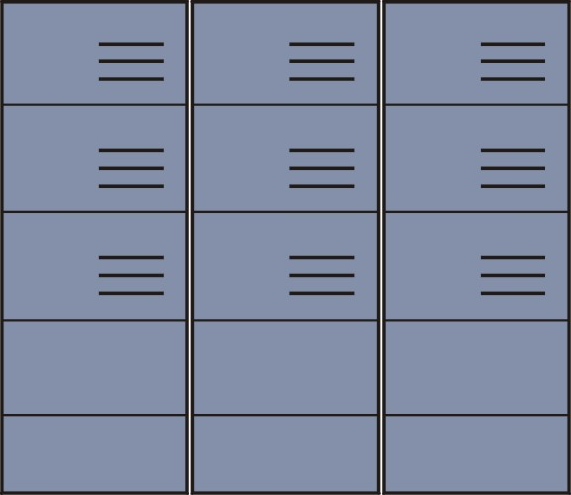
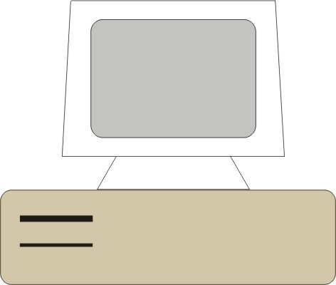

Power/Performance/Efficiency
All computers, given enough time and memory, are capable of computing exactly the same things
=
=
Smartphone
Desktop
Supercomputer

Slide 8
Theory vs. Practice
In theory, computers can “compute” anything that’s possible to compute
given enough memory and time
In practice, “solving problems” involves computing under constraints
time
weather forecast, next frame of animation, ...
cost
iPod, automotive engine controller, ...
power
smartphone, tablet, ...

Slide 9
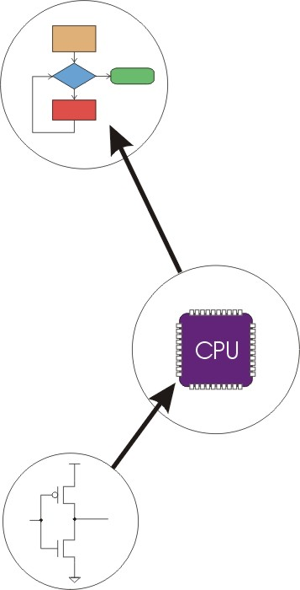
Layers of Abstraction
Problems
Algorithms
Language
Instruction Set Architecture
Microarchitecture
Circuits
Devices

Slide 10
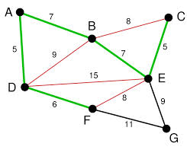
More precisely
Problem Statement
stated using "natural language"
may be ambiguous, imprecise
Algorithm
step-by-step procedure, recipe, guaranteed to finish
definiteness, effective computability, finiteness
Program
express the algorithm using a computer language
high-level language, low-level language
Instruction Set Architecture (ISA)
specifies the set of instructions the computer can perform
data types, addressing mode, hardware/software interface

Slide 11
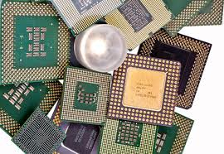
More precisely
Microarchitecture
detailed organization of a processor implementation
different implementations of a single ISA
Logic Circuits
combine basic operations to realize microarchitecture
many different ways to implement a single function (e.g., addition)
Devices
properties of materials, manufacturability

Slide 12
Problem solving with computation
A systematic sequence of transformations between layers of abstraction
Problem
Software Design:
choose algorithms and data structures
Algorithm
Programming:
use language to express design
Program
Compiling/Interpreting:
convert language to machine instructions
Instruction Set
Architecture

Slide 13
Problem solving with computation
A systematic sequence of transformations between layers of abstraction
Instruction Set
Architecture
Processor Design:
choose structures to implement ISA
Microarch
Logic/Circuit Design:
gates and low-level circuits to implement components
Circuits
Process Engineering & Fabrication:
develop and manufacture lowest-level components
Devices

Slide 14
References
Introduction to Computing Systems: From bits & gates to C & beyond 2nd Edition
by Yale Patt and Sanjay Patel
Chapter 1: Welcome Aboard

Slide 15
Introduction to Embedded Systems and the ZebBoard Platform

Slide 16

Topics to be covered
Introduction to the Embedded Systems
Introduction to the ZedBoard
Introduction to Linux
ZedBoard Software

Slide 17
Embedded Processors
Processor System (PS)

Slide 18
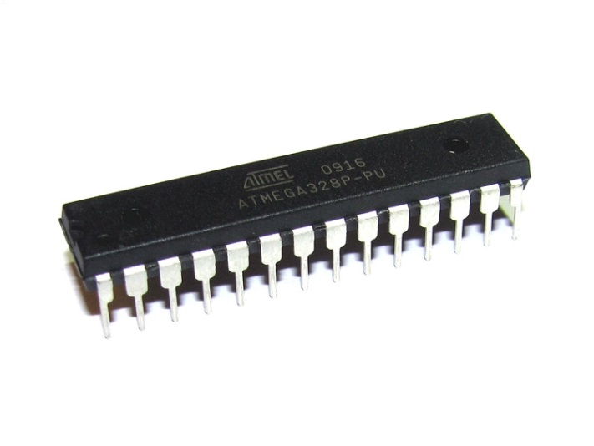
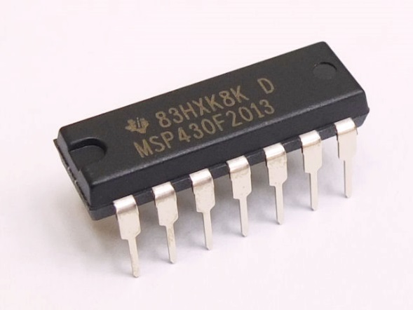
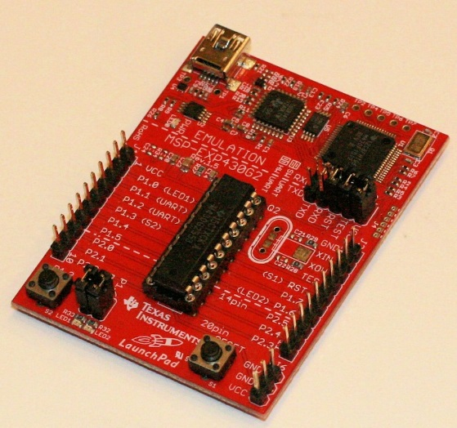

Examples of Microcontrollers
MSP430 (16 bits)
Atmega328 (8 bits)
MSP430 Lauchpad
Arduino Uno

Slide 19
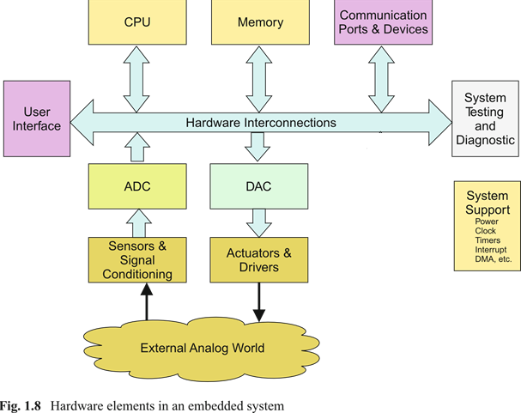
Embedded System Architecture

Slide 20
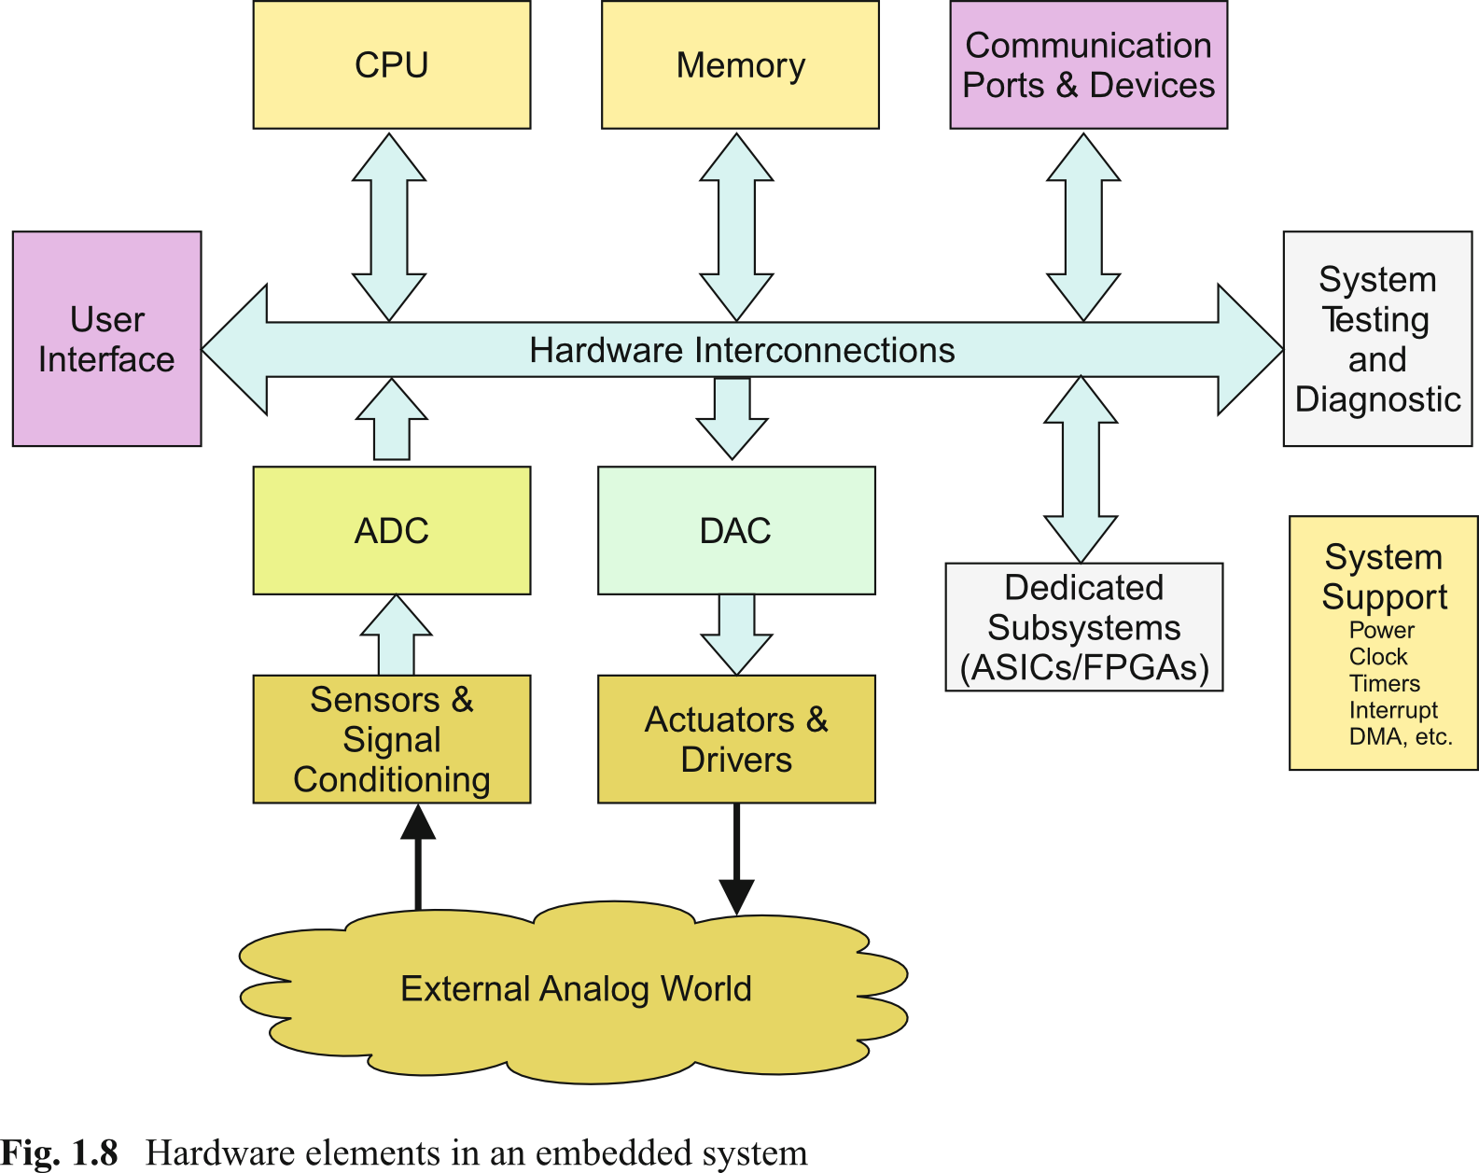
Embedded System Architecture
Additional processors

Slide 21
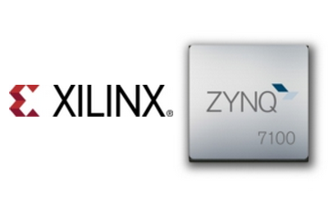
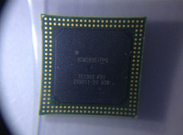
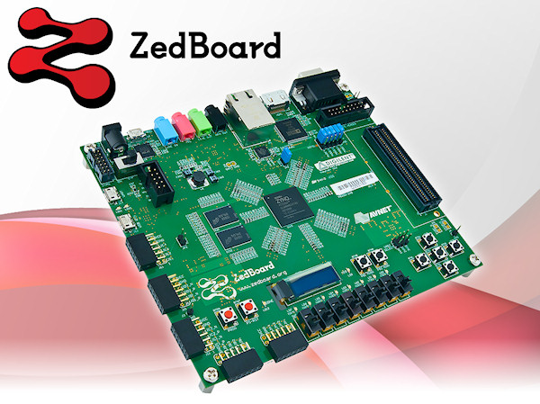
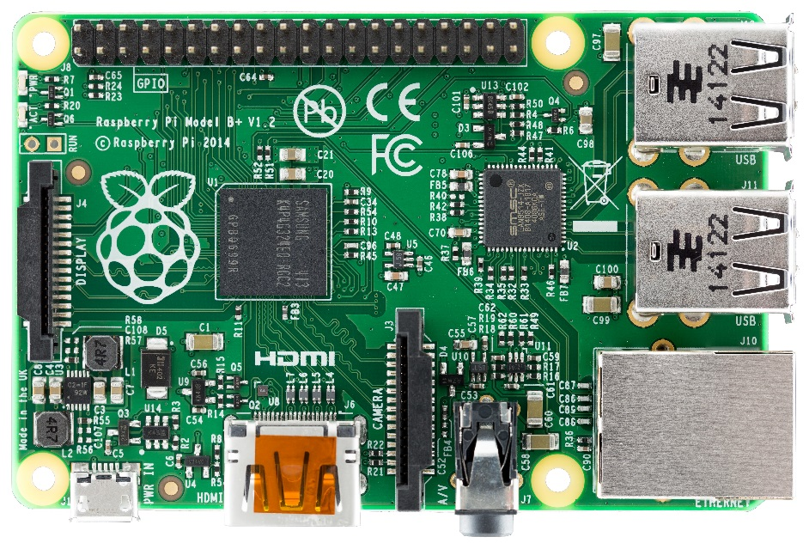
Examples of System on Chip Processors
Zynq SoC
Broadcom BCM2835
Raspberry PI

Slide 22
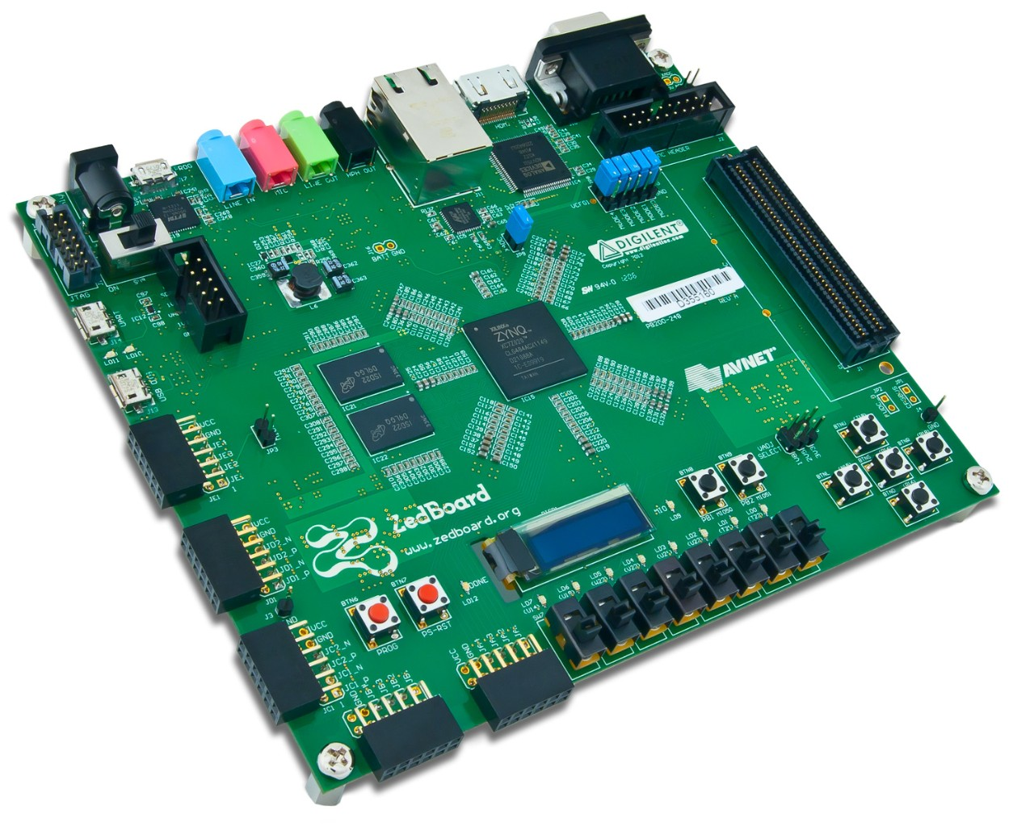
ZedBoard

Slide 23
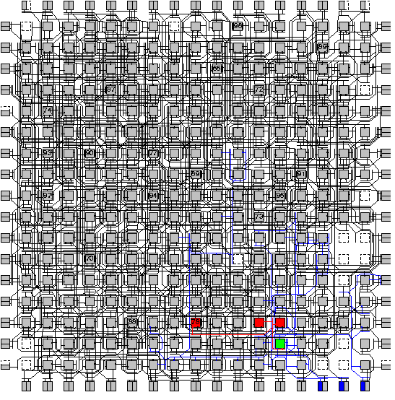
System on Chip Processors
Programmable Logic (PL) (FPGA Fabric)
Processor System (PS)
+
OR
GPUs
Digital Signal Processors (DSPs
Other ASICs

Slide 24

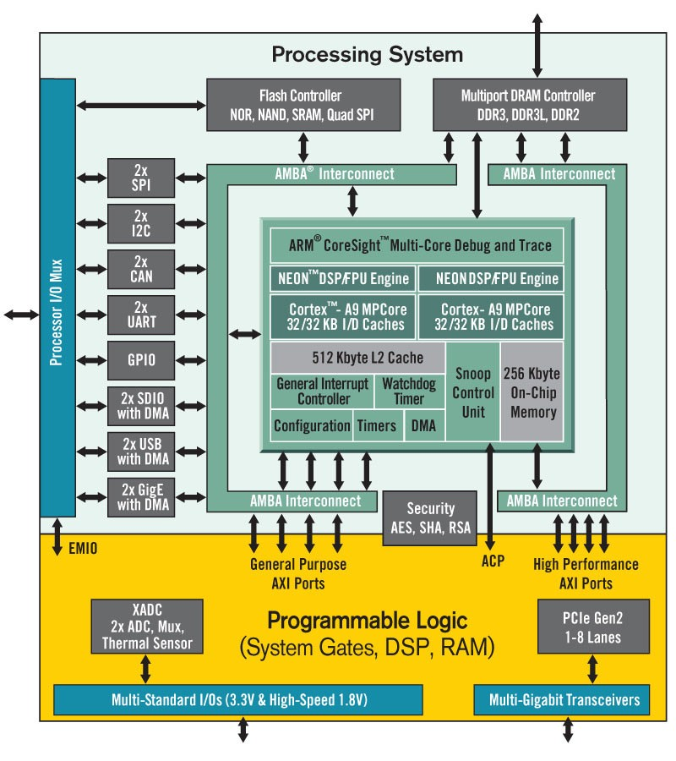
Zedboard (ZYNQ SoC)
Dual ARM® Cortex™-A9 MPCore™ with CoreSight™
32 KB Instruction, 32 KB Data per processor L1 Cache
512 KB unified L2 Cache
256 KB On-Chip Memory
2x UART, 2x CAN 2.0B, 2x I2C, 2x SPI, 4x 32b GPIO
2x USB 2.0 (OTG), 2x Tri-mode Gigabit Ethernet, 2x SD/SDIO on-chip peripherals
85K logic slices, each with four 6-input LUTs and 8 flip-flops
560 Kbits of fast block RAM
Four clock management tiles, each with phase-locked loop (PLL)
220 DSP slices
Internal clock speeds exceeding 450MHz
2x 12 bit, 1 MSPS On-chip analog-to-digital converter (XADC)

Slide 25
ZedBoard
Feature | Description
FPGA | Zynq-7000 AP SoC XC7Z020-1CLG484
I/O Interfaces | USB-UART for programming and serial communication One 10/100/1G Ethernet USB OTG 2.0 USB-UART bridge 12-bit VGA output HDMI Output I2S CODEC Audio Line-In, Line-Out, headphone, microphone
Memory | 512 Mbyte DDR3 256 Mbit Quad-SPI Flash SD card connector
Displays | One 128x32 OLED
Switches and LEDs | 8 Slide switches accessible from PL 8 LEDs accessible from PL 1 LED accessible from PS 5 Push-buttons accessible from PL 2 Push-buttons accessible from PS 1 Reset button accessible from PL 1 Reset button accessible from PS
Clocks | One 100 MHz Oscillator for PL one 33.333 MHz Oscillator for PS
Expansion ports | One LPC FMC One AMS Header One header for XADC signals 5 Pmod ports

Slide 26
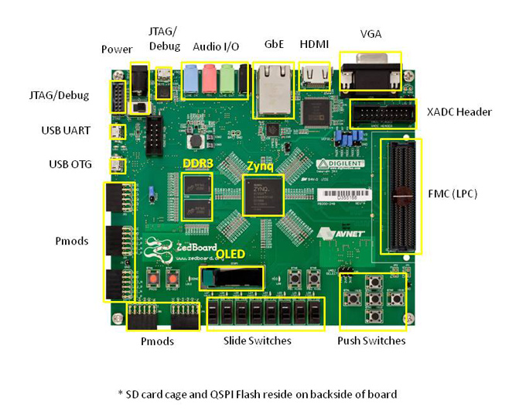
ZedBoard

Slide 27
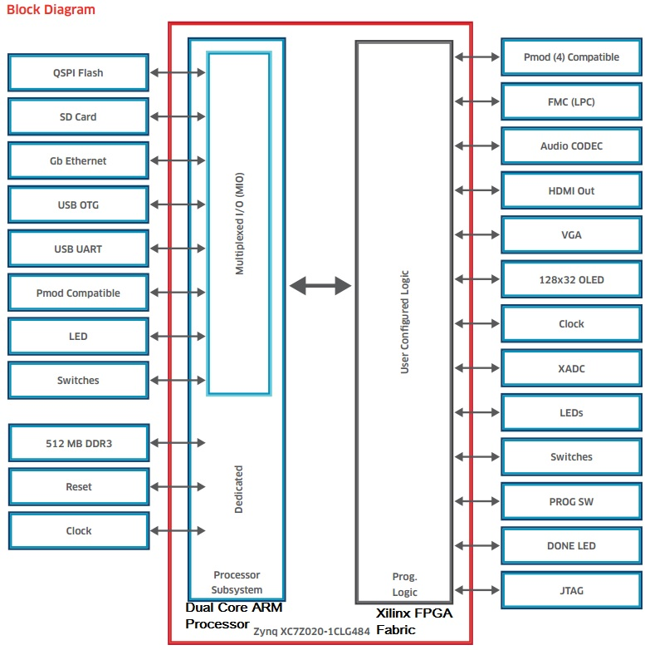
Zedboard (ZYNQ SoC)

Slide 28

Origins of Linux
(1969) Unix – AT&T Bell Laboratories – (System 5 flavor)
Ken Thompson and Dennis Richie
Rewritten in C to make it portable – key enabler
(1983) GNU project – free Unix – Berkeley Software Distribution (BSD) (System 4.3 flavor)
(1985) Intel introduced the 80386 microprocessor
Supported multitasking and virtual memory management
(1987) MINIX – Unix-like OS for academic teaching
Andrew Tanenbaum

Slide 29
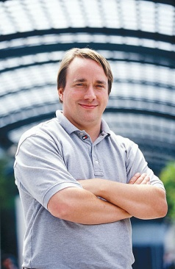

Origins of Linux
(1991) Linus Torvalds began a project that grew into the Linux kernel
Initially targeted specifically for the 80386
Written in C
(1992) Released under GNU General Public License (i.e., free software)
(1994) Red Hat and SUSE provide version 1.0 distributions
(1996) – Version 2.0 and (2011) – Version 3.0

Slide 30
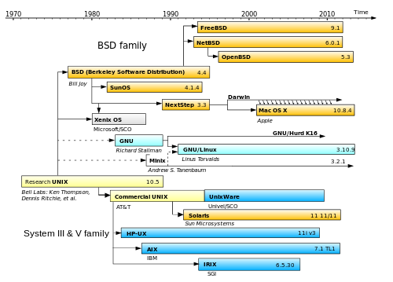
Unix Flavors
History of Unix: http://www.levenez.com/unix/

Slide 31
ZedBoard Software
Platform we will use provides xiLinux
xiLinux is a fullblown graphical Linux distribution based upon Ubuntu 12.04
xiLinux includes the Xillybus IP core and driver plus a few other things
Xillybus is a straightforward, portable, intuitive, efﬁcient DMA-based solution for data transport between an FPGA and a host running Linux
We will discuss Xillybus in more detail when we start to program the FPGA

Slide 32
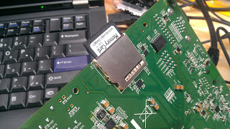
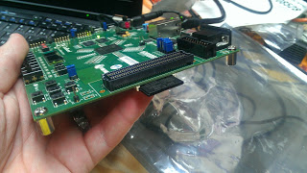
ZedBoard Software
xiLinux is running on one of the two ARM CPUs
xiLinux provides a version of gcc
xiLinux provides a writeable filesystem on the ZedBoard’s SD card
A boot.bin file is created to initial the runtime environment on the ZedBoard

Slide 33
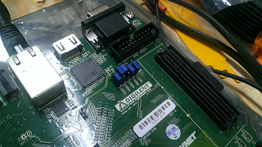
ZedBoard Jumpers
For the board to boot from the SD card, modiﬁcations to the jumper settings need to be made
The correct setting is depicted in the image:

Slide 34
ZedBoard
We will use a ssh client mobaxterm to connect from the host PC to the ZedBoard
We may use both a serial interface across USB and tcp/ip over ethernet
We will cover more about this during the first few weeks of lab

